Slide 1

Smart Healthcare Appointment and Management System
Team Members:-
Pruthviraj KL
Bhuvi
Dinesh
JayKanth
Mantosh kumar
Submitted To :-
Mr. Kanagaraj

Slide 2
Objective:
- To build a digital healthcare solution that allows patients to book appointments online, manage their bookings, and consult with doctors remotely.
- Streamline appointment management for healthcare providers to reduce manual errors and improve overall efficiency.
Key Goals:
1. Convenient booking from any device.
2. Enable remote consultations.
3. Digital medical records management.
4. Real-time notifications.

Slide 3
Existing System Comparison
Existing platforms like HealthTap, Practo and Zocdoc provide core features such as online appointment booking, telemedicine, and digital medical records. However, they have some limitations:
1. Lack of Real-Time Notifications
2. Digital Prescription
3. Less Integration with Smaller Healthcare Providers
4. No Seamless Payment API Integrations
5. Limited Customization

Slide 4

Key Features

Slide 5

For Patients:
Registration & Login: Quick sign-up and secure access.
Doctor Search: Search by specialization, location, and availability.
Appointment Booking & Management: Book, reschedule, or cancel appointments.
Remote Consultation: Video consultations for non-urgent cases.
Medical Records Access: Access prescriptions and treatment history.

Slide 6

For Doctors:
Dashboard: Overview of appointments, patient history, and prescriptions.
Availability Management: Set and update availability easily.
Patient Management: View patient profiles, past consultations, and issue new prescriptions.
Digital Prescriptions: Provide e-prescriptions that patients can access online.

Slide 7

Workflow
1. Registration/Login: Secure authentication for patients.
2. Doctor Search & Booking: Filter doctors, book appointments.
3. Real-Time Notifications: SMS/Email updates for confirmations and reminders.
4. Virtual Consultation: Video calls with access to medical history.
5. Prescription Issuance: Doctors provide e-prescriptions after consultations.

Slide 8
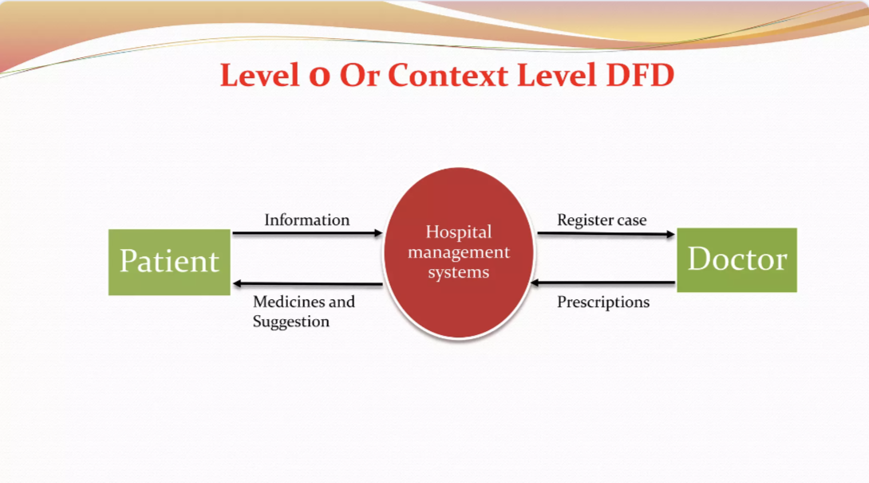
Workflow(DFD)

Slide 9
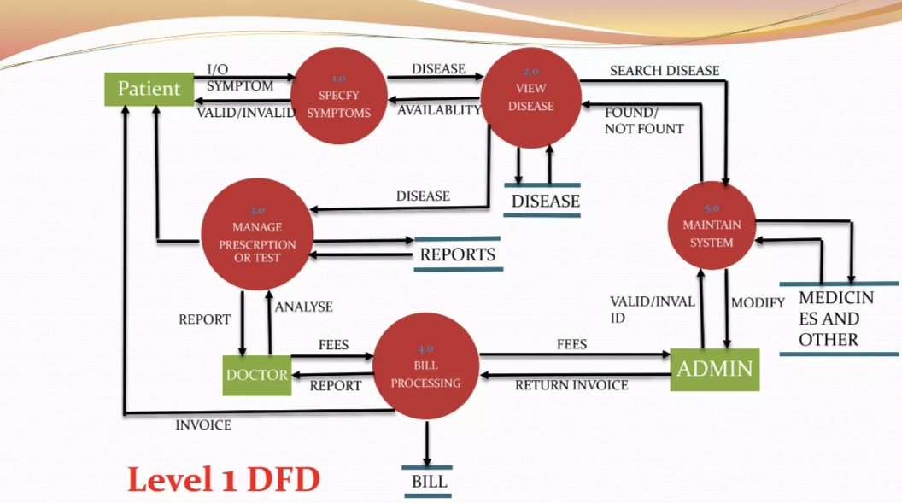
Workflow(DFD)
Doctor

Slide 10
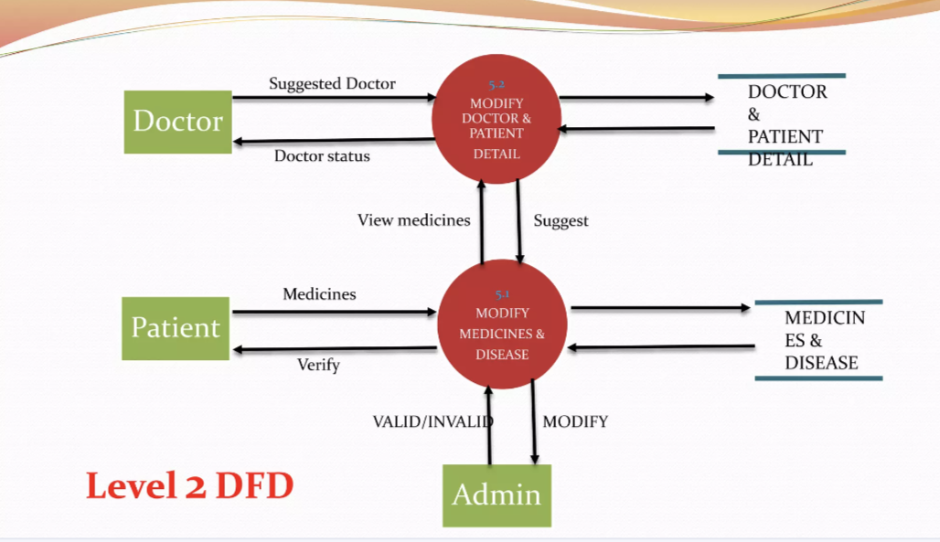
Workflow(DFD)

Slide 11

System Overview
Frontend :
html, CSS, JavaScript, JSP,
Backend :
Java 11 , jdbc , j2ee
Database:
MySQL

Slide 12

Benefits
1.For Patients
2.For Doctors
3. Security Measures

Slide 13
For Patients: 1. 24/7 access to medical services. 2. convenient, reduced waiting times, and remote consultations. 3. centralized, secure medical records. For Doctors: 1. efficient scheduling 2. availability management 3.access to patient records. Security Measures: 1. data encryption 2.multi-factor authentication (mfa). 3.compliance with healthcare regulations (hipaa/gdpr).

Slide 14
Future Scope of the Smart Healthcare Appointment and Management System
AI-Powered Predictive Healthcare
Integration with IoT and Wearables
Advanced AI-Based Medical Assistance
Virtual and Augmented Reality (VR/AR) for Medical Training and Patient Education

Slide 15
Disadvantage:
Technical Issues: System failures can disrupt appointments.
Data Privacy Concerns: Risks of data breaches and unauthorized access.
User Resistance: Patients and staff may resist adopting new technology.
Limited Personal Interaction: Reduced face-to-face communication with providers.
Training Requirements: Staff training can be time-consuming and resource-intensive.
Access Inequality: Disparities in technology access among patients.
Scalability Challenges: Difficulty adapting the system as the organization grows

Slide 16
CONCLUSION:
A comprehensive digital healthcare solution designed to enhance convenience and efficiency for both patients and doctors, with room for future expansion such as data analytics and cloud scalability.

Slide 17

THANK YOU

